Slide 1
System Call Programming & Debugging
Week 7

Slide 2
Processor Modes
Operating modes that place restrictions on the type of operations that can be performed by running processes
User mode: restricted access to system resources
Kernel/Supervisor mode: unrestricted access
System resources?
Memory
I/O Devices
CPU

Slide 3
User Mode vs. Kernel Mode
Hardware contains a mode-bit, e.g. 0 means kernel mode, 1 means user mode
User mode
CPU restricted to unprivileged instructions
Supervisor/kernel mode
CPU is unrestricted, can use all instructions, access all areas of memory and take over the CPU anytime

Slide 4
Why Dual-Mode Operation?
System resources are shared among processes
OS must ensure:
Protection
an incorrect/malicious program cannot cause damage to other processes or the system as a whole
Fairness
Make sure processes have a fair use of devices and the CPU

Slide 5
How to Achieve Protection and Fairness
Goals:
I/O Protection
Prevent processes from performing illegal I/O operations
Memory Protection
Prevent processes from accessing illegal memory and modifying kernel code and data structures
CPU Protection
Prevent a process from using the CPU for too long
=> instructions that might affect goals are privileged and can only be executed by trusted code

Slide 6
Which Code is Trusted?
Only the kernel code is trusted
The kernel is the core of the OS
Interface between h/w and s/w
It controls access to system resources
implements protection mechanisms
Mechanisms cannot be changed through actions of untrusted software in user space
Notes:
The OS is the kernel + application (window manager, text editor, compiler)

Slide 7
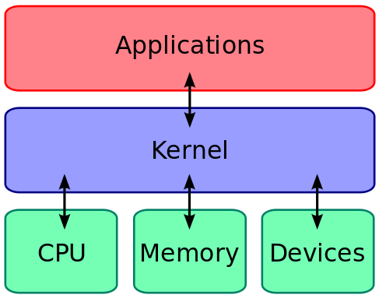
What About User Processes?
The kernel executes privileged operations on behalf of untrusted user processes

Slide 8
System Calls
Special type of function that:
Used by user-level processes to request a service from the kernel
Changes the CPU’s mode from user mode to kernel mode to enable more capabilities
Is part of the kernel of the OS
Verifies that the user should be allowed to do the requested action and then does the action (kernel performs the operation on behalf of the user)
Is the only way a user program can perform privileged operations

Slide 9
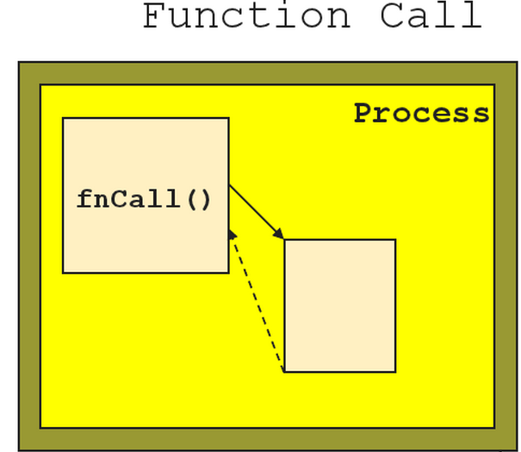
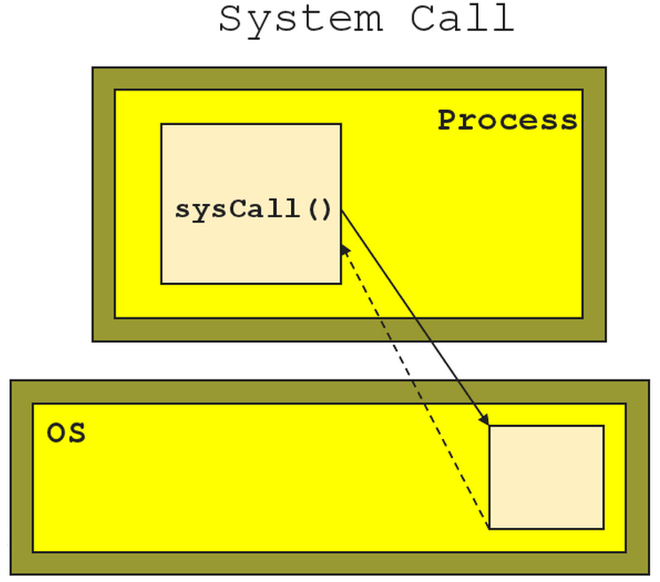
Function Call vs. System Call
Caller and callee are in the same process
Same “domain of trust”
Control is transferred from the untrusted user process to the trusted OS

Slide 10
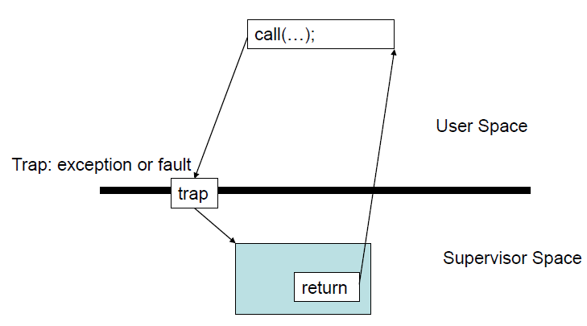
System Calls
When a system call is made, the program being executed is interrupted and control is passed to the kernel
If operation is valid the kernel performs it

Slide 11
System Call Overhead
System calls are expensive and can hurt performance
The system must do many things
Process is interrupted & computer saves its state
OS takes control of CPU & verifies validity of op.
OS performs requested action
OS restores saved context, switches to user mode
OS gives control of the CPU back to user process

Slide 12
Library Functions
Functions that are a part of standard C library
To avoid system call overhead use equivalent library functions
getchar, putchar vs. read, write (for standard I/O)
fopen, fclose vs. open, close (for file I/O), etc.
How do these functions perform privileged operations?
They make system calls

Slide 13
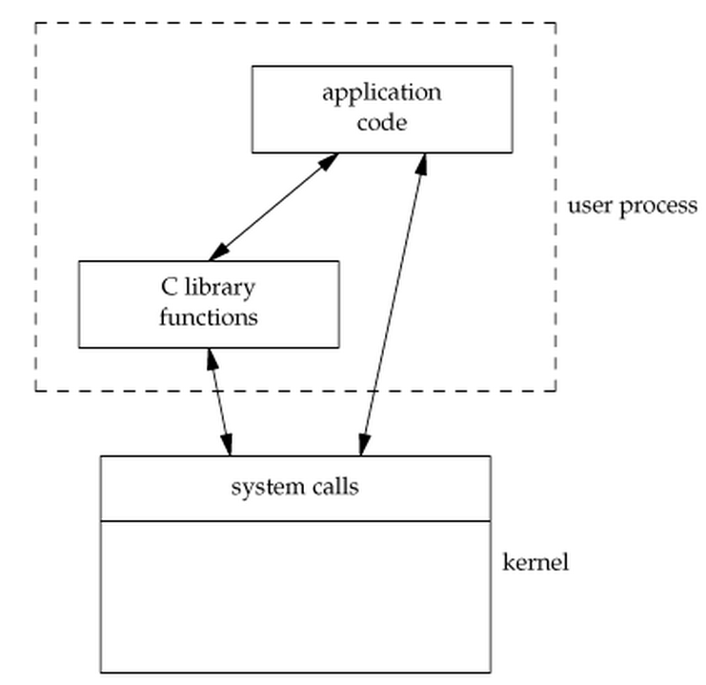
So What’s the Point?
Many library functions invoke system calls indirectly
So why use library calls?
Usually equivalent library functions make fewer system calls
non-frequent switches from user mode to kernel mode => less overhead

Slide 14
Unbuffered vs. Buffered I/O
Unbuffered
Every byte is read/written by the kernel through a system call
Buffered
collect as many bytes as possible (in a buffer) and read more than a single byte (into buffer) at a time and use one system call for a block of bytes
=> Buffered I/O decreases the number of read/write system calls and the corresponding overhead

Slide 15
Buffered I/O
Writing to a file:
fwrite() copies outgoing data to a local buffer as long as it’s not full and returns to the caller immediately
When buffer space is running out, fwrite() calls the write() system call to flush the buffer to make room
Reading from a file:
fread() copies requested data from the local buffer to user's process as long as the buffer contains enough data
When the buffer is empty, fread() calls the read() system call to fill the buffer with data and then copies data from the buffer

Slide 16
Lab 7
Write 2 versions of the tr program
Version 1 (tr2b.c)
Library functions: getchar and putchar for copying
Version 2 (tr2u.c)
System calls: read and write for copying
Usage: cat file | tr2(b/u) from to
from & to are sets of equal length
If sets are not of equal length or translation is ambiguous → error
Use strace to compare the number of system calls issued by each version when
Copying one file to another (cat file1 | tr2 from to > file2)
Copying a file to your terminal (cat file1 | tr2 from to)
Use time to measure how much faster one program is than the other

Slide 17
time and strace
time [options] command [arguments...]
Output:
real 0m4.866s: elapsed time as read from a wall clock
user 0m0.001s: the CPU time used by your process
sys 0m0.021s: the CPU time used by the system on behalf of your process
strace: intercepts and prints out system calls to stderr or to an output file
strace –o strace_buf_output ./tr2b from to < test
strace –o strace_unbuf_output ./tr2u from to < test

Slide 18
Part 1: Rewrite sfrob
New program is sfrobu
Uses unbuffered I/O: read/write instead of getchar/putchar
If input is a regular file, use fstat to get the size of the file and allocate enough memory for it
If input is not regular, use malloc-realloc method from assignment 5
Print the number of comparisons made using fprintf
Estimate the # of comparisons as a function of the # of input lines
Measure differences in performance between sfrob and sfrobu using time

Slide 19
read System Calls
include <unistd.h>
size_t read(int filedes, void* buf, size_t nbytes);
Field | Description
int fildes | The file descriptor of where to read the input. You can either use a file descriptor obtained from the open system call, or you can use 0, 1, or 2, to refer to standard input, standard output, or standard error, respectively.
void *buf | A character array where the read content will be stored.
size_t nbytes | The number of bytes to read before truncating the data. If the data to be read is smaller than nbytes, all data is saved in the buffer.
return value | Returns the number of bytes that were read. If value is negative, then the system call returned an error. If value is 0, then end of file is reached.

Slide 20
write System Calls
include <unistd.h>
size_t write(int filedes, const void* buf, size_t nbytes);
Field | Description
int fildes | The file descriptor of where to write the output. You can either use a file descriptor obtained from the open system call, or you can use 0, 1, or 2, to refer to standard input, standard output, or standard error, respectively.
const void *buf | A null terminated character string of the content to write.
size_t nbytes | The number of bytes to write. If smaller than the provided buffer, the output is truncated.
return value | Returns the number of bytes that were written. If value is negative, then the system call returned an error.

Slide 21
fstat
include <sys/stat.h>
int fstat(int filedes, struct stat *buf) ;
struct stat fileStat;
FILE * fp = fopen(filename, “r”);
int fd = fileno(fp);
if(fstat(fd,&fileStat) < 0)
return 1; //error
printf("File Size: %d bytes\n",fileStat.st_size);
fclose(fp);
Field | Description
int fildes | The file descriptor of the file that is being inquired.
struct stat *buf | A structure where data about the file will be stored. The fields of the structure can be found in here.
return value | Returns a negative value on failure.

Slide 22
Part 2: Shell Script
sfrobs
Same functionality as sfrob but uses tr and sort to sort encrypted input
Script shouldn’t use any temporary files (use pipes)
compare the performance of sfrobs to sfrob and sfrobu using time
#! /bin/bash
cat | tr ? ? | sort | tr ? ?
Tip: you can represent any byte in tr using octal notation (e.g \000)

